Slide 1
Hospital Management System
By Project Group No: 5
Chinmay Mahajan (PRN: 240343020027)
Devendrasing Kachhhawa (PRN: 240343020030)
Yash Sakharwade (PRN: 240343020109)
Rahul kumar Diyewar(PRN: 240343020079)
Notes:
H

Slide 2


Slide 3
Hospital Management System:
Purpose:
This software will help the hospital to be more efficient in registration of their patients, records of patients and bed booking. It enables doctors and admin to view patients details.The HMS reduces the physical workload on staff and ensures that patient records and room assignments are managed efficiently, with all data easily accessible for future reference.

Slide 4
Problem Statement:
The problem is, queuing at hospital is often managed manually by administrative staff, then take a token there and then wait for our turn then ask for the doctor and the most frustrating thing - we go there by traveling a long distance and then we come to know the doctor is on leave or the doctor can’t take appointments. In some areas of country there are no medical facilities and people don’t have access to any physical medical facilities.
Goals Of Project:
This web application will digitalize all the details regarding the patient and the hospital. The installation of this healthcare software results in improvement in administrative functions and hence better patient care, which is the prime focus of any healthcare unit.

Slide 5



This System has 3 modules:
2. Patient
3. Doctor
1. Admin

Slide 6

Technologies Used:
Java, C#, .NET Core Web API, Entity Framework, Spring Boot REST API, JPA, React JS, Bootstrap, MySQL, GitHub

Slide 7
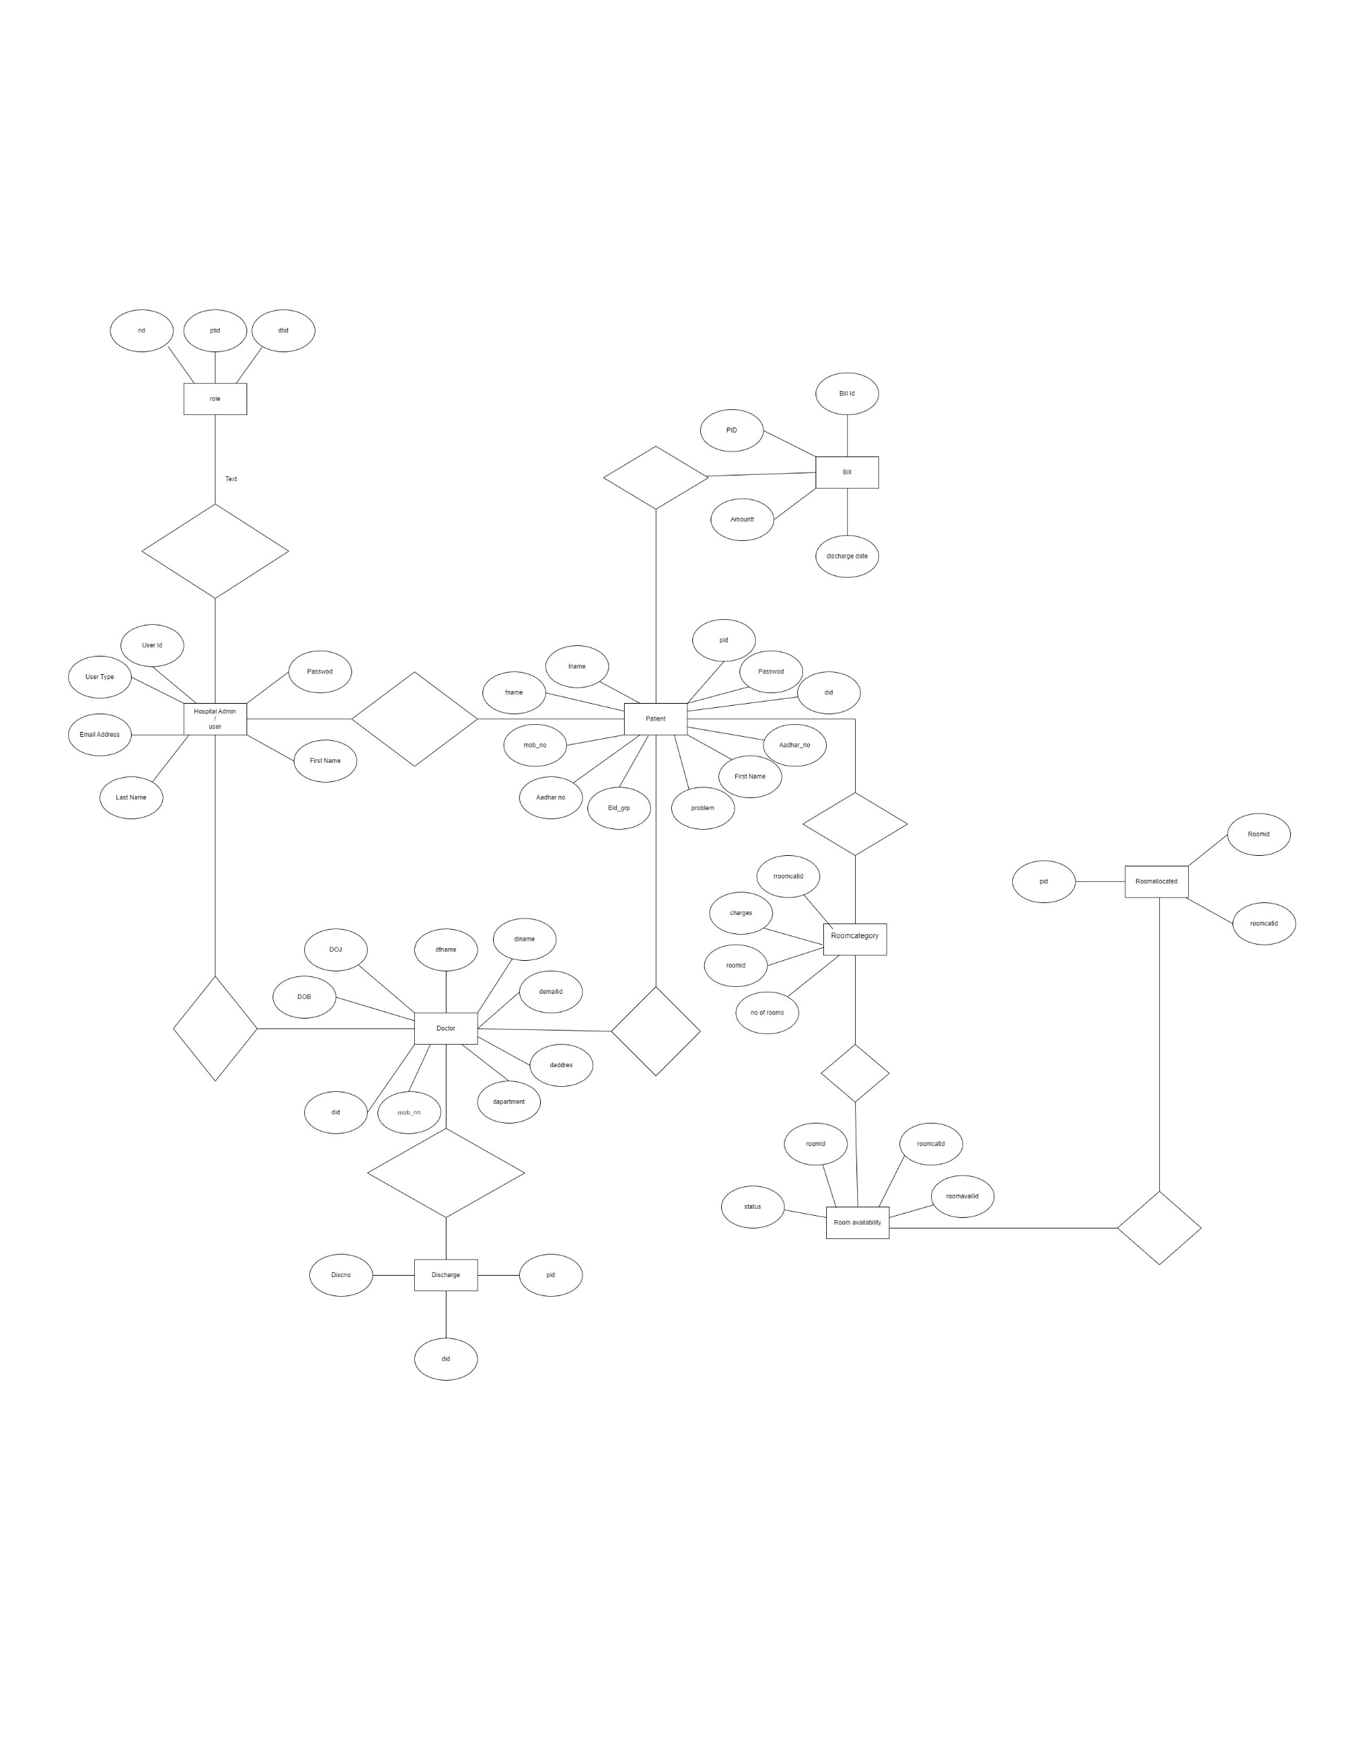
E-R Diagram:

Slide 8
Future Scope :
Expansion of Modules: Additional modules for inventory management, pharmacy integration, and billing automation could further streamline hospital operations, making the HMS a comprehensive solution for healthcare management.

Slide 9
Conclusion:
The Hospital Management System (HMS) developed by our team successfully addresses the challenges faced by healthcare institutions in managing patient records,bed allocations, and overall administrative tasks.By digitalizing the registration process, room assignments, and access to patient details, the HMS significantly reduces the workload on hospital staff, improves efficiency, and enhances patient care.

Slide 10
Thank You

